Slide 1






BUNO
BLIND AIDE PROTOTYPE Enhancing safe and independent navigation
PRESENTED BY:
Abdullah burak karatepe
Tran Cong Minh Nguyen
Aaron Varghese James
Ashwath BharathiraJA
COURSE: FSE 100
INSTRUCTOR: Dr. Ayca Tuzmen
DATE: 23-04-2026

Slide 2

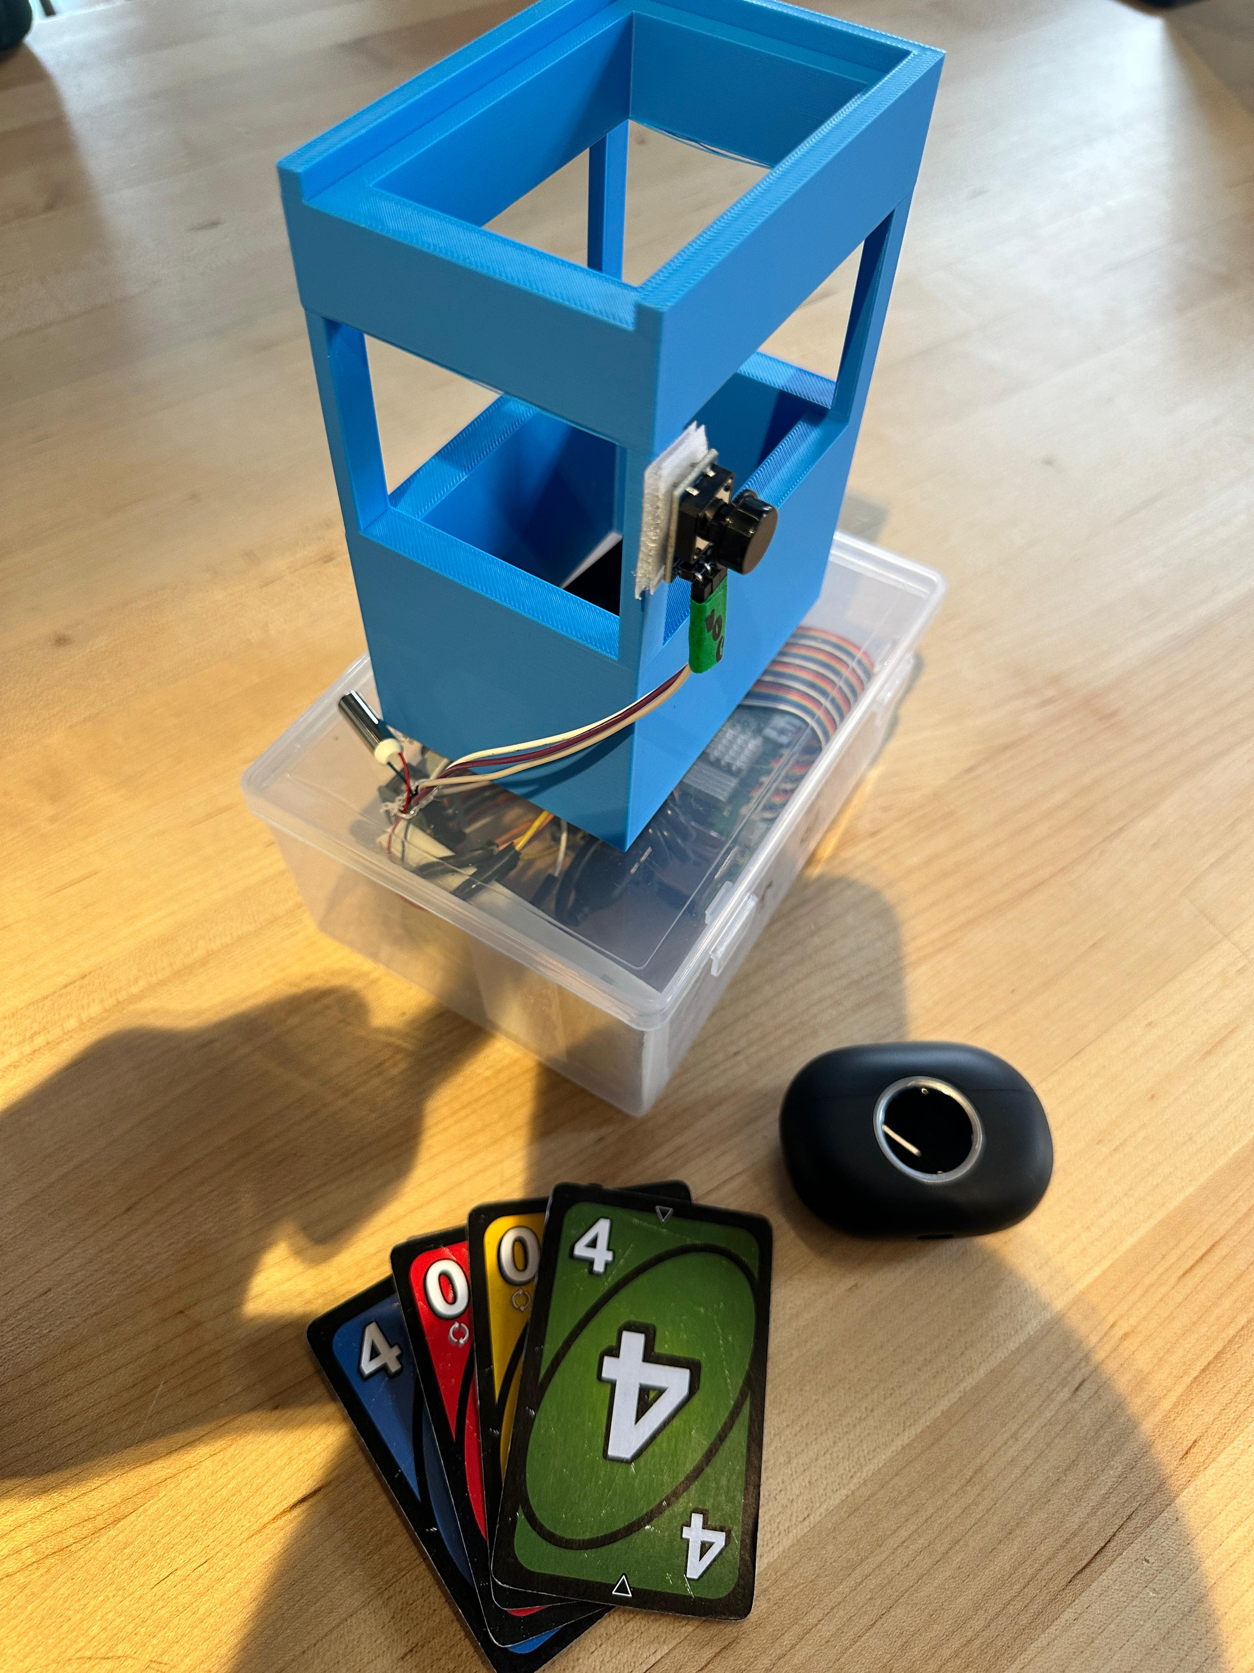
Problem & Motivation
Blind and visually impaired people have limited access to common card games like UNO
Existing games are mostly visual and not accessible without help
This reduces social interaction with sighted friends
We designed an accessible UNO game for blind and sighted players
Players can enjoy the game independently and fairly
The system uses a simple setup with a transparent mechanism box and a blue card-detection box
A camera reads the card, and the system gives audio and vibration feedback
Users place a card, press a button, feel vibration for confirmation, then hear card number and color via headphones
BUNO — Accessible Gaming · Raspberry Pi · OpenCV · TensorFlow Lite · pyttsx3 · RPi.GPIO

Slide 3
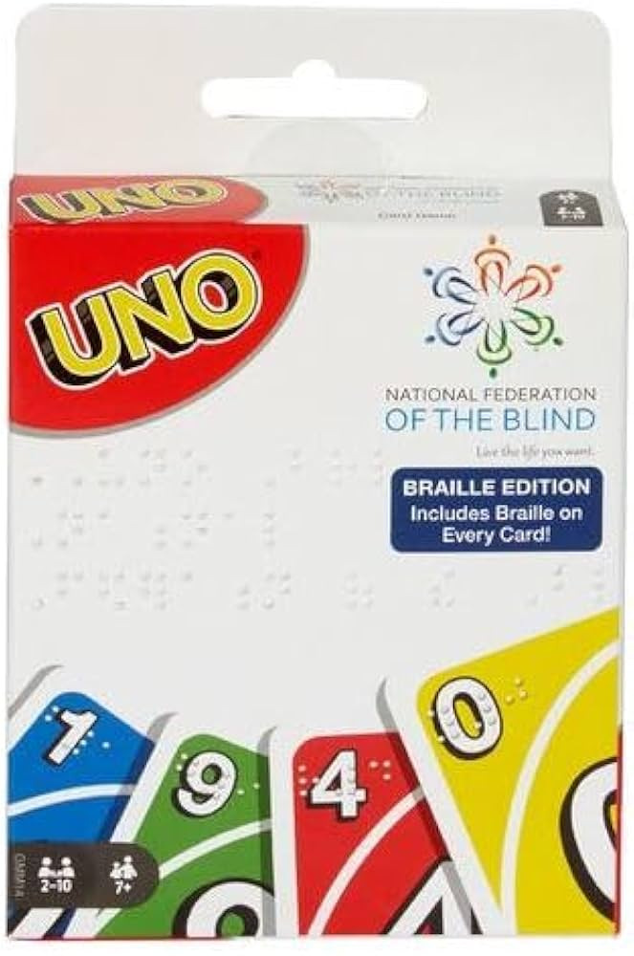
Existing Solutions
Existing similar solutions:
Braille UNO cards (raised symbols for tactile reading)
Audio-based card games with pre-recorded instructions
Mobile apps that read cards using a camera and text-to-speech
Assistive board/card games designed for visually impaired users
Limitations of existing solutions:
Often require constant tactile reading (slow gameplay)
Not well integrated for both blind and sighted players together
Limited real-time interaction and game feedback
Usually need separate tools (phone/app, special cards, etc.)
BUNO — Accessible Gaming · Raspberry Pi · OpenCV · TensorFlow Lite · pyttsx3 · RPi.GPIO

Slide 4
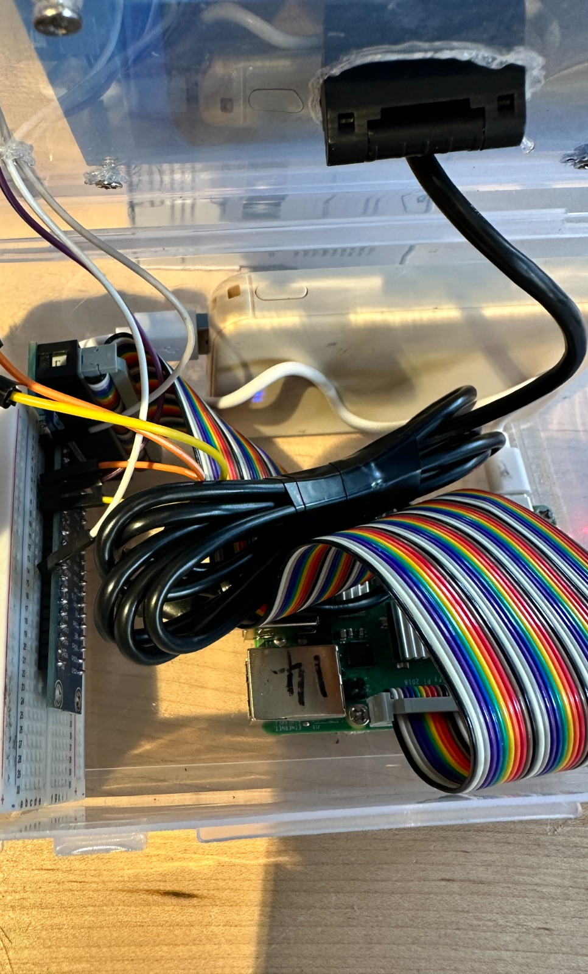
Proposed Solution
We developed an accessible UNO system for both blind and sighted players
Players can play together without needing assistance
A camera-based system detects the card placed on the device
A simple button interface is used to interact with the system
Audio output announces the card’s number and color via headphones
Vibration (buzzer) provides physical feedback for successful actions
A two-part box design is used:
Transparent lower box contains the main mechanism
Blue upper box helps position the card correctly for the camera
Goal: create a fully accessible, real-time, and inclusive card game experience
BUNO — Accessible Gaming · Raspberry Pi · OpenCV · TensorFlow Lite · pyttsx3 · RPi.GPIO

Slide 5
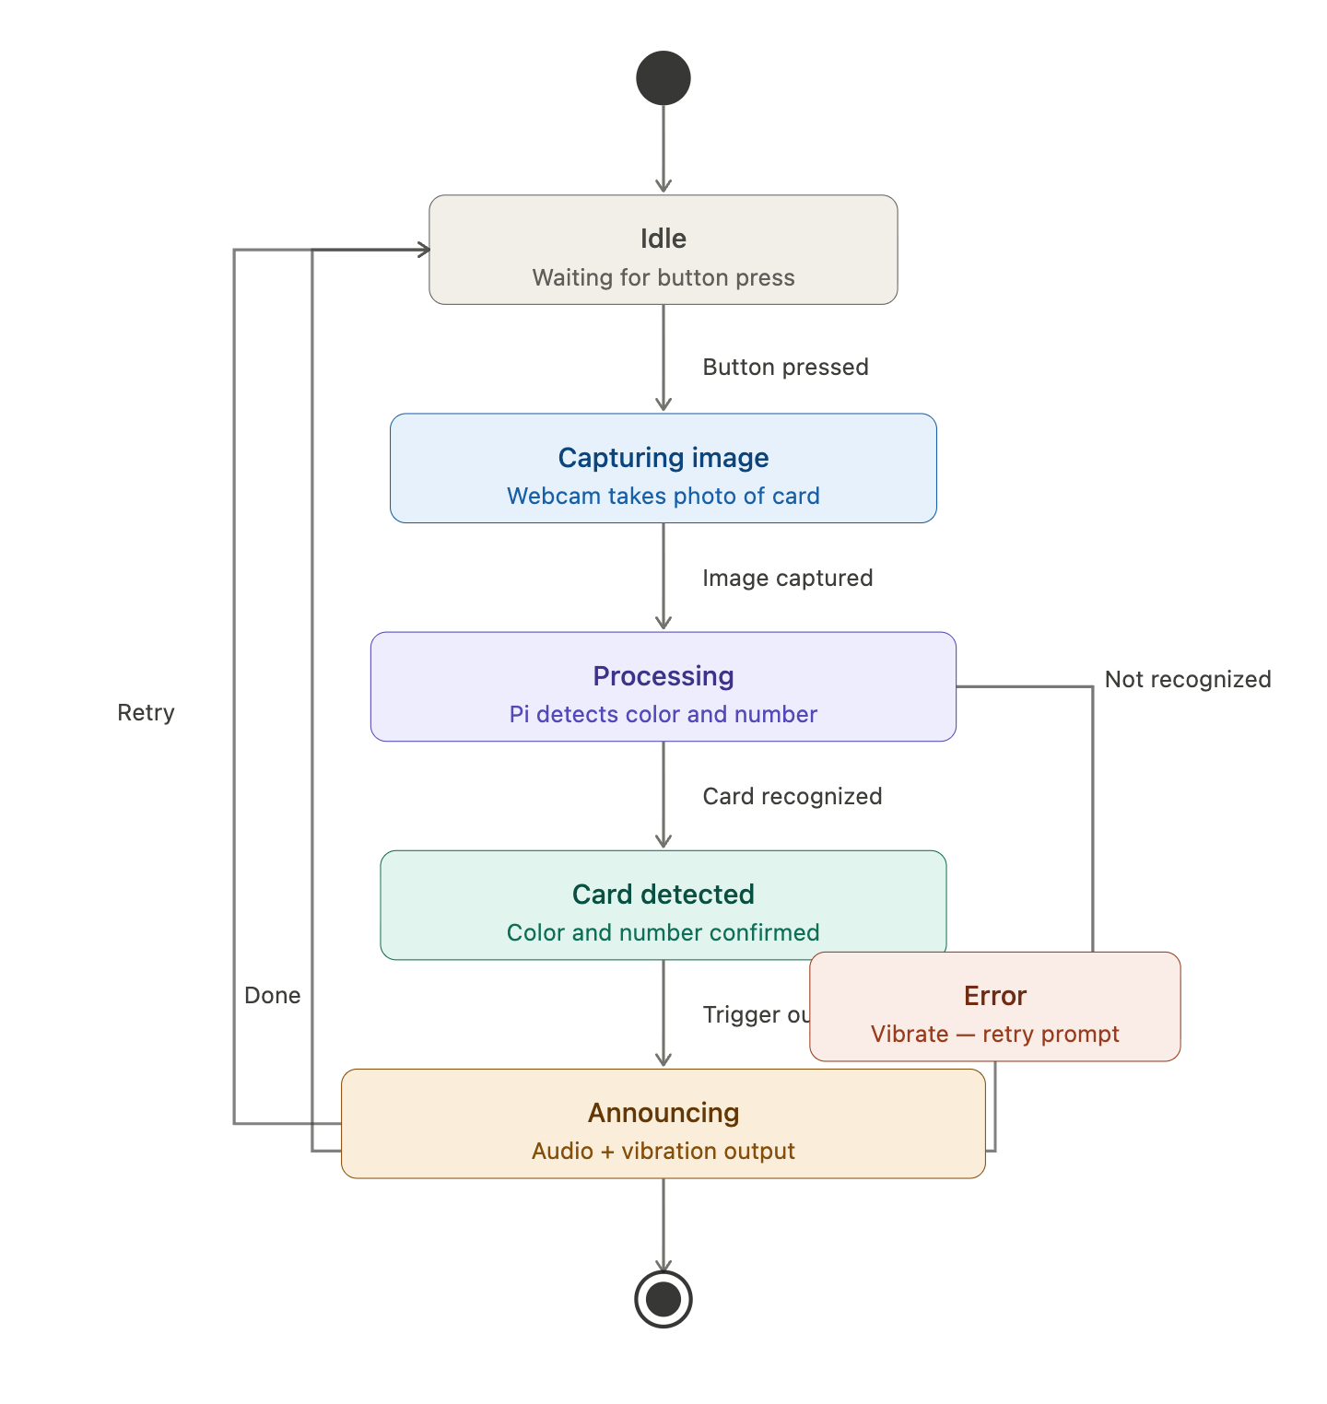
System
Architecture
BUNO — Accessible Gaming · Raspberry Pi · OpenCV · TensorFlow Lite · pyttsx3 · RPi.GPIO

Slide 6
Camera module for card detection
Microcontroller (processing unit)
Transparent mechanism box
Components
Blue card positioning box
Push button (user input)
Buzzer (vibration feedback)
Headphones (audio output)
BUNO — Accessible Gaming · Raspberry Pi · OpenCV · TensorFlow Lite · pyttsx3 · RPi.GPIO

Slide 7
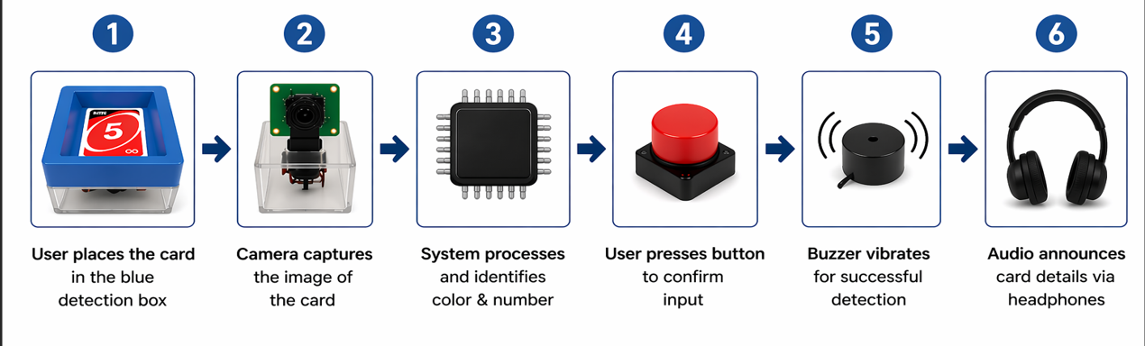
WORKING PROCESS
The system provides both audio (via headphones) and vibration (via buzzer) feedback to ensure an accessible and engaging gameplay experience.
BUNO — Accessible Gaming · Raspberry Pi · OpenCV · TensorFlow Lite · pyttsx3 · RPi.GPIO

Slide 8
PRODUCT DESIGN
Design Overview
The system is built with a two-part box structure that ensures accurate card detection, user convenience, and accessibility.
Key Design Features
Two-part box structure for usability
Transparent lower box to house internal components and mechanism
Blue upper box to help position the card accurately for the camera
Simple button interface for user input
Audio output through headphones for clear feedback
Vibration (buzzer) for physical confirmation
Compact, durable, and user-friendly design
Accessible for both blind and sighted players
Design Goals
Ensure accurate card detection and reliable feedback
Provide an inclusive and fair gaming experience
Enable real-time interaction with audio and vibration feedback
BUNO — Accessible Gaming · Raspberry Pi · OpenCV · TensorFlow Lite · pyttsx3 · RPi.GPIO

Slide 9
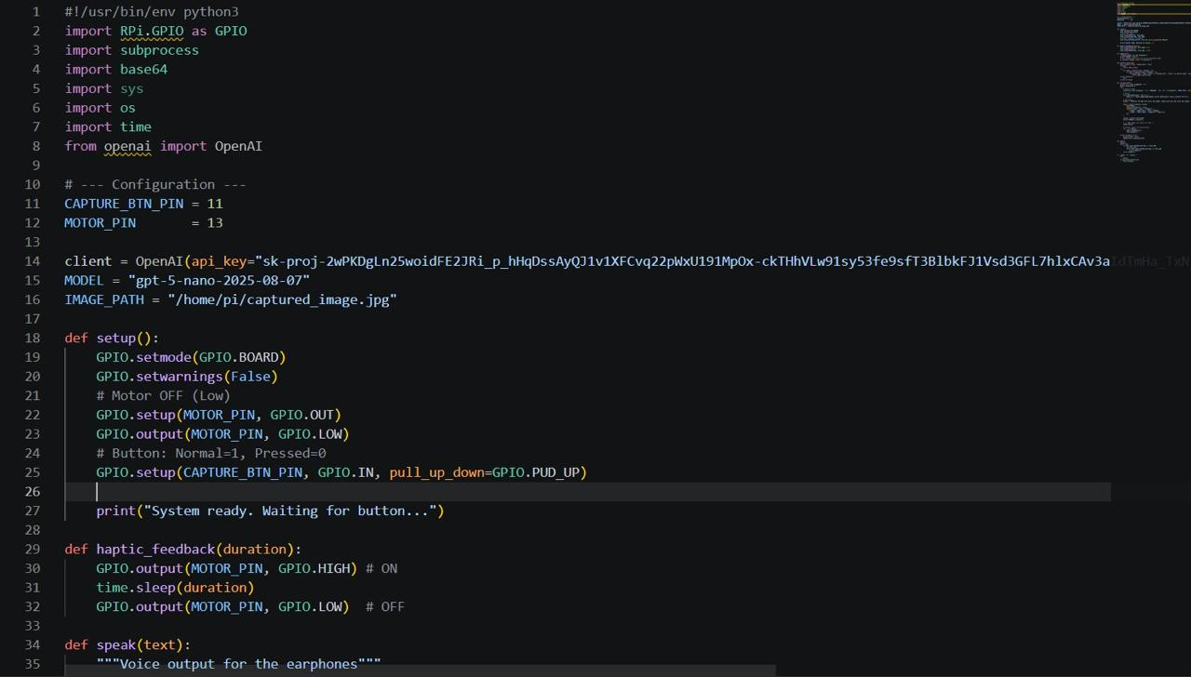
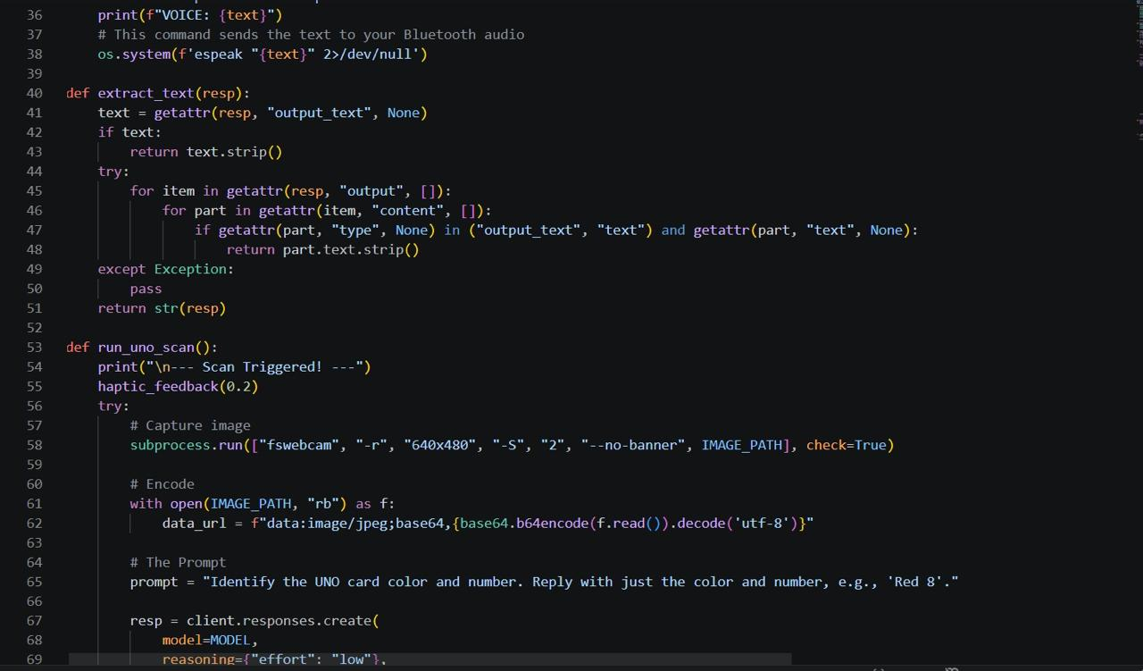
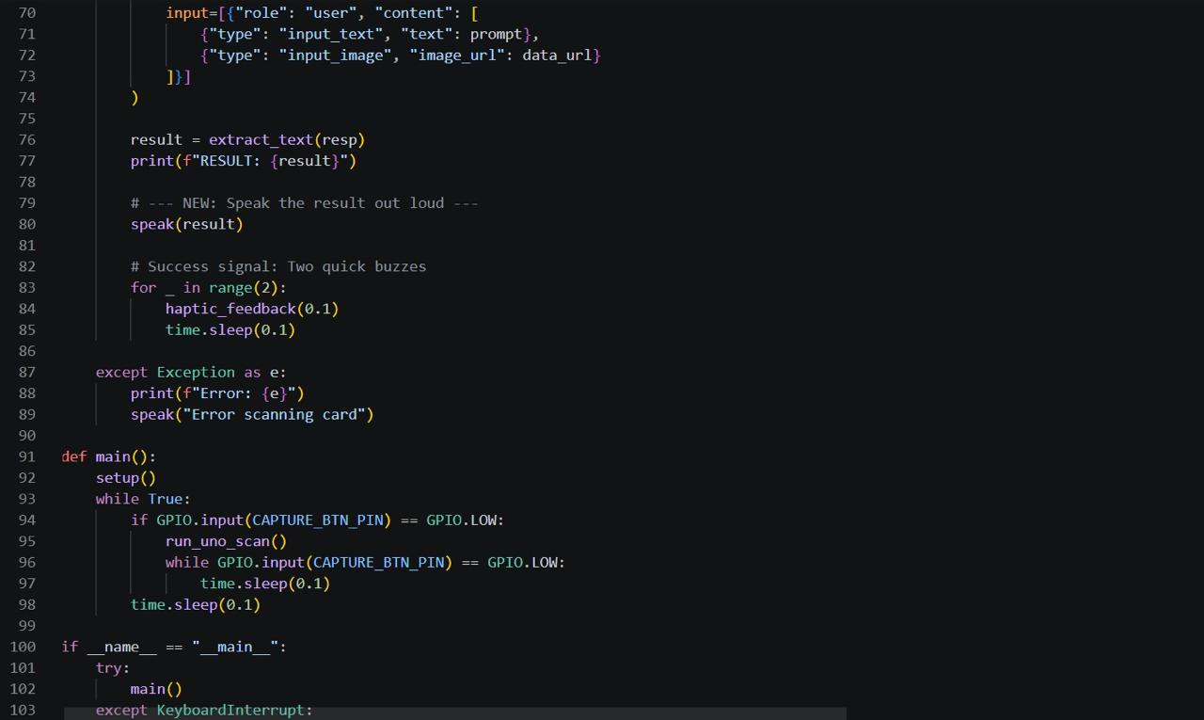
CODE
BUNO — Accessible Gaming · Raspberry Pi · OpenCV · TensorFlow Lite · pyttsx3 · RPi.GPIO

Slide 10






Implementation
9
Hardware · Software · Detection · Output · Logic · Enhancements
Hardware Setup
Card Detection
Audio Output
• Connect webcam to Raspberry Pi via USB
• Wire vibration motor to GPIO via transistor
• Connect push button with pull-up resistor
• Plug earphone into 3.5mm audio jack
• Capture frame on button press via OpenCV
• Preprocess: resize, denoise, enhance contrast
• Detect card color using HSV color masking
• Identify number using ML model or Tesseract OCR
• Install pyttsx3 or espeak for TTS
• Convert card info (e.g. 'Green 4') to speech
• Announce special cards: Skip, Reverse, Wild
• Support multi-language TTS output
Haptic Feedback
Main Loop Logic
Enhancements
• Pulse vibration motor on successful scan
• Error pattern vibration if card not recognized
• Use RPi.GPIO to control motor via transistor
• Distinct patterns for different game events
• Poll GPIO button state continuously
• On press: capture → process → output → idle
• Handle exceptions for unrecognized cards
• Retry prompt on failed detection
• Multiplayer turn tracking with audio cues
• Confidence threshold for re-scan if low score
• Special card announcements (Draw Two, Wild)
• Battery pack for full portability
BUNO — Accessible Gaming · Raspberry Pi · OpenCV · TensorFlow Lite · pyttsx3 · RPi.GPIO

Slide 11



Testing & Results
10
Card Recognition · Response Time · Accuracy · User Feedback
92%
1.2s
100%
Card Recognition
Accuracy
Avg. Response
Time
Special Cards
Detected
Test Cases
Results
User Feedback
• Tested all 4 colors: Red, Blue, Green, Yellow
• Tested number cards (0–9) and action cards
• Tested in bright, dim & artificial lighting
• Tested with worn, bent & partially covered cards
• Number cards: 95% accuracy under good lighting
• Color detection: 98% accuracy across all shades
• Action cards (Skip/Reverse/Wild): 89% accuracy
• Low light conditions reduced accuracy to ~78%
• Visually impaired testers found audio clear & helpful
• Vibration alerts were intuitive and responsive
• Button press felt natural and easy to locate
• Requested faster scan time & louder audio output
BUNO — Accessible Gaming · Raspberry Pi · OpenCV · TensorFlow Lite · pyttsx3 · RPi.GPIO

Slide 12
Conclusion
12
Conclusion & Improvements
Conclusion
Improvements
▸ Makes UNO accessible for visually impaired players using affordable hardware
▸ Train custom ML model for better card recognition in varied lighting
▸ Combines computer vision, audio & haptic feedback in a compact 3D-printed device
▸ Add multiplayer turn tracking & score announcement system
▸ Proves inclusive game design is achievable without expensive commercial solutions
▸ Replace wired button with Bluetooth remote for easier handling
▸ Built with low-cost components — Raspberry Pi, webcam, vibration motor
▸ Optimize TensorFlow Lite model for faster, low-latency detection
▸ Bridges the gap between accessibility and everyday entertainment
▸ Add rechargeable battery pack for full portability
BUNO — Accessible Gaming · Raspberry Pi · OpenCV · TensorFlow Lite · pyttsx3

